Slide 1
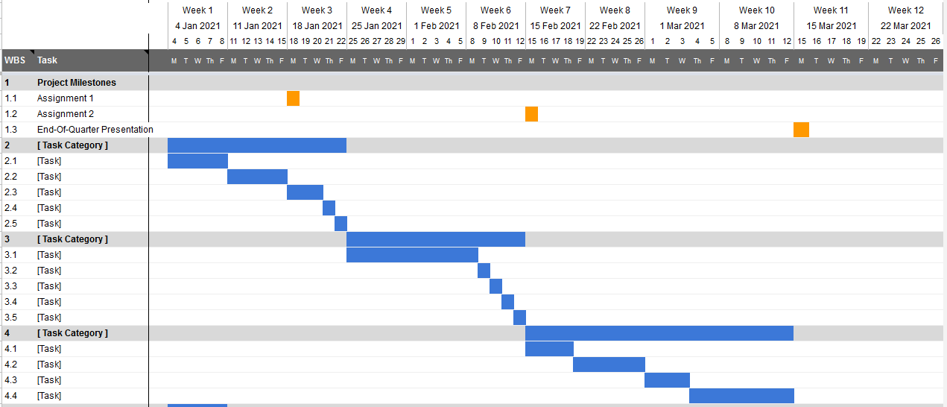
Overview
Project Name Team Members
Overall Concept:
Overall Project Deliverable | Progress
System Diagram/ Concept Poster
Minimal Changes Week to Week
Project is On Schedule
Gantt Chart/Schedule
As soon as this is available

Slide 2
Short-Term
Project Name Team Members
Previous Meeting Action Items:
Item | Description | Owner | Target Date | Status
1
2
3
4
5
6
Biweekly Action Items:
Item | Description | Owner | Target Date | Status
1
2
3
4
5
6
Significant Roadblocks/ Non-developing Items:
Budget:
As soon as this is available
Total Proposed | Plan to Date | Used to Date | Used Vs Plan
$xxxx USD | $000USD | $000 USD | +/-$000 USD
Short Term Schedule:
Request for teaching staff:
Feb |  |  |  |  |  |  |  |  |  | Feb
31 |  |  |  |  | 7 |  |  |  |  | 14

Slide 3
Add Detail sheets as necessary to clarify activity
Detail

Slide 4
Example

Slide 5
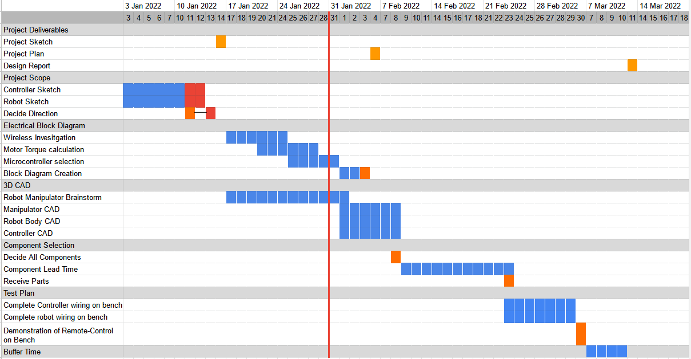
Overview
Project Name Team Members
Overall Concept:
Overall Project Deliverable | Progress
Project Scope Decision | ⬛⬛⬛⬛⬛
Complete Electrical Block Diagram | ⬛⬛🟥⬜⬜
Complete 3D CAD for mechanical design | ⬛⬜⬜⬜⬜
Component selection/BOM selection | ⬜⬜⬜⬜⬜
Test Plan Creation | ⬜⬜⬜⬜⬜
Electrical Bench Test | ⬜⬜⬜⬜⬜
Mechanical Construction | ⬜⬜⬜⬜⬜
Testing | ⬜⬜⬜⬜⬜
Design Correction | ⬜⬜⬜⬜⬜
Create remote-controlled Wheeled Robot with grasper capable of lifting 50 lbs
Project is On Schedule
Gantt Chart/Schedule

Slide 6
Short-Term
Project Name Team Members
Previous Meeting Action Items:
Item | Description | Owner | Target Date | Status
1 | Robot Manipulator Brainstorm | All | 02-Feb | ⬛⬛⬛⬛⬛
2 | Motor Torque Calculation | Student A | 27-Jan | ⬛⬛⬛⬛⬜
3 | Evaluate wireless communication protocol | Student B | 24-Jan | ⬛⬛⬛⬛⬛
4
5
6
Biweekly Action Items:
Item | Description | Owner | Target Date | Status
1 | Decide microcontroller (Arduino vs Raspberry Pi) | Student B | 01-Feb | ⬜⬜⬜⬜⬜
2 | Finalize Motor Torque Calculation | Student A | 04-Feb | ⬛⬛⬛⬛⬜
3 | Create outer frame 3D CAD | Student C | 09-Feb | ⬛⬜⬜⬜⬜
4 | Create controller 3D CAD | Student A | 09-Feb | ⬜⬜⬜⬜⬜
5 | Robot Block Diagram Creation | Student B | 07-Feb | ⬜⬜⬜⬜⬜
6 | Controller Block Diagram | Student B | 12-Feb | ⬜⬜⬜⬜⬜
Significant Roadblocks/ Non-developing Items:
Budget:
Significant Roadblocks/ Non-developing Items:
-Bluetooth-compatible Arduino shield is out of stock
-Team is struggling to gain access to 3D CAD tools
-Motor Torque Calculation is taking longer than expected
Total Proposed | Plan to Date | Used to Date | Used Vs Plan
$1,250 USD | $000USD | $000 USD | +/-$000 USD
Short Term Schedule:
Request for teaching staff:
Feb |  |  |  |  |  |  |  |  |  | Feb
31 |  |  |  |  | 7 |  |  |  |  | 14
-Industry Mentor is being unresponsive. Help push mentors to attend weekly meetings
Project Plan
Initial Part Order

Slide 7
Detail
2 Week Recap:
Option 1
Option 2
Option 3
Option 4
 | Option 1 | Option 2 | Option 3 | Option 4
Cost | S | - | + | ++
Number of Components | S | - | + | +
Complexity | S | - | S | +
Range of Motion | S | S | S | --
Durability | S | ++ | S | -
Grasping Ease | S | S | - | -
Total | 0 | -1 | +1 | 0
Robot Grasper direction has been decided

